Slide 1

PSYCHOLOGICAL ANALYSIS USING SOCIAL MEDIA TWEETS
SRM INSTITUTE OF SCIENCE AND TECHNOLOGY
SCHOOL OF COMPUTING
DEPARTMENT OF COMPUTING TECHNOLOGIES
18CSP109L – MAJOR PROJECT
Student 1 Reg. No: RA2011003010810
Student 1 Name: Kartik Singh
Student 2 Reg. No: RA2011003010772
Student 2 Name: Utkarsh Gupta
Guide name: Mrs. P .Renukadevi
Designation: Assistant Professor Department: Computing Technologies
17-05-2024

Slide 2
Abstract
Our project is dedicated to developing a proficient and precise method for analyzing psychological indicators of depression through social media, particularly Twitter, utilizing Deep Learning Algorithm techniques.
Depression is a prevalent mental health concern, and early detection is essential for timely intervention and support.
The project encompasses various stages, starting with the preprocessing of social media data to enhance its quality, followed by the extraction of pertinent features related to psychological well-being. These features will then be employed to train and evaluate various ML models.
Our proposed approach harnesses the capabilities of Deep Learning to discern intricate patterns and connections within social media content, facilitating accurate classification of psychological states related to depression.
17-05-2024

Slide 3
Introduction
Identifying depression through psychological analysis involves deploying cutting-edge technologies, including Deep Learning Algorithm and Artificial Intelligence (AI).
Notable ML algorithms like Long Short Term Memory (LSTM) and Convolutional Neural Network (CNN) have been explored in our research.
Our findings indicate that the LSTM+CNN model exhibits commendable accuracy in addressing the challenge of depression identification.
The younger generation, active on social media, utilizes these platforms to express thoughts and opinions on diverse topics and situations.
17-05-2024

Slide 4
Motivation
Understanding Human Behavior : Analyzing tweets offers valuable insights into human behavior and attitudes, providing a real-time glimpse into societal trends and perceptions.
Predictive Analytics : Through advanced analytics, such as sentiment analysis, social media data can be used to develop predictive models, enhancing decision-making and strategy development.
Targeted Support : Psychological analysis of tweets enables the identification of individuals in need of support or intervention, allowing for personalized assistance tailored to their specific needs.
Ethical Considerations : It's essential to prioritize privacy and ethical guidelines when conducting psychological analysis using social media data, ensuring responsible use and minimizing potential risks.
17-05-2024

Slide 5
Literature Survey
S. No | Title | Author and Publication | Journal Name | Problem/ Motivation | Methodology
1 | Sentiment Analysis in Social Media Data for Depression detection Using Artificial Intelligence: A Review | Nirmal Varghese Babu, E. Grace Mary Kanaga. | SN Computer Science in 2022 | All the input data consists of small non relevant words which when included increases the wait time of prediction module | Feature Extraction techniques in this paper involves: N-Gram Tokenization Negation Handling Bag of Words Which when combined reduces the processing group from initial raw data
2 | Psychological Analysis for Depression Detection from Social Networking Sites | Sonam Gupta, Lipika Goel, Arjun singh, Ajay Prasad, Mohammad Aman Ullah | Hindawi, Computational Intelligence and Neuroscience in 2022 | Social media platforms consists of rich amount of data to showcase and perform psychological classification tasks. | Methodology implemented are based on the dataset used. We classify basic human emotions into common 6 categories.

Slide 6
Literature Survey
S. No | Title | Author and Publication | Journal Name | Problem/ Motivation | Methodology
3 | Deep neural networks for depression recognition based on 2D and 3D facial expressions under Emotional Stimulus Tasks | Weitong Guo, Hongwu Yang, Zhenyu Lie, Yaping Xu and Bin Hu | Frontiers in Neuroscience Original Research in 2021 | Using a generative model that uses multiple layers of feature-detecting neurons. It can learn hierarchical representation from input raw data | This paper uses 10-fold cross-validation to evaluate experiments for excluding the differences caused by individuality and over-fitting.
4 | Multisource social media data sentiment analysis using bidirectional recurrent convolutional neural networks. | Abid F, Li C, Alam M | Comput Commun in 2020 | Lexicon based techniques which determine sentiment polarity of tweet or sentence by checking them from pre-established dictionary | Lexicon-based strategies are very efficient and simple methods. They make use of a sentiment lexicon to assign a polarity value to each text document by following a basic algorithm.

Slide 7
Literature Survey
S. No | Title | Author and Publication | Journal Name | Problem/ Motivation | Methodology
5 | Multisource social media data sentiment analysis using bidirectional recurrent convolutional neural networks. | Abid F, Li C, Alam M | Comput Commun 2020 | They introduced neural network model that is a combination of CNNs and RNNs alluded as a general encoding architecture that utilizes both neural network layers | The method uses CNN for feature extraction and then kernel based extreme learning machines (KELM) for recognition.
6 | Anxious depression prediction in real-time social data | Kumar A, Sharma A, Arora A | International Conference on advanced engineering, science, management and technology in 2019 | The frequency and timing of tweet is primarily associated with odd hour posting. | Accuracy and F-score measures are used to evaluate the performance of the ensemble vote classifier. The accuracy of the ensemble vote predictive model is compared to the three individual classifiers.

Slide 8
Existing Methods & Techniques
Feature Extraction Techniques –
1. TF-IDF (Term Frequency Inverse Document Frequency): Calculating the importance of words in a document by considering both their frequency in the document and their inverse frequency across a set of documents.
2. Term Document Matrix (TDM): Describing the total number of words in a document collection, where columns represent terms and rows represent documents.
3. Bag-of-Words (BOW): Representing text by depicting the presence of words within a document, involving a vocabulary of known words and their total presence.
4. Negation Handling (Negmas) : Determining the scope of negation and inverting polarities of opinionated words influenced by a negation.
5. LIWC (Linguistic Inquiry and Word Count): Measuring the total number of various word categories used in a text and processing textual content.
17-05-2024

Slide 9
Existing Methods & Techniques
Machine Learning Techniques –
1.Support Vector Machines (SVM): SVMs are powerful classifiers that aim to find the best hyperplane that separates different classes in a high-dimensional feature space. They have been applied to MRI-based brain tumor classification by using extracted features.
2.Long-Term Short Memory (LSTM): LSTMs, a type of recurrent neural network, excel in capturing long-term dependencies in sequential data, making them effective for tasks like sentiment analysis and depression identification in social media text.
3.Artificial Neural Networks (ANN): ANNs are computational models inspired by the human brain's structure. They can learn complex relationships in data and are used for feature extraction and classification in brain tumor detection.
4.Convolutional Neural Networks (CNN): CNNs are deep learning architectures designed to handle images effectively. They can automatically learn hierarchical features from raw images, making them popular for medical image analysis, including brain tumor detection.
17-05-2024

Slide 10
Challenges and Limitations
Integration of Emoticons : Incorporating emoticons and emojis in sentiment analysis poses a challenge due to their diverse interpretations, requiring sophisticated natural language processing (NLP) techniques for accurate classification.
Binary and Ternary vs. Multi-class Classification: The transition from Binary and Ternary Classification to Multi-class Classification introduces complexities in sub-class division based on polarities, demanding meticulous handling of diverse sentiment expressions within the social media data.
Machine and Deep Learning Techniques: While machine learning and deep learning techniques are employed for sentiment classification, the challenge lies in optimizing their application to social media data, where the dynamic nature of language and expressions requires adaptive models.
Sentiment Monitoring Precision: Monitoring sentiment levels on social media involves challenges in accurately identifying and analyzing the nuances of apprehensiveness or dejection, demanding more nuanced feature extraction methods and sentiment analysis models.
17-05-2024

Slide 11
Objectives:
Data Collection and Preprocessing: Gather a comprehensive dataset of social media tweets and perform preprocessing tasks such as cleaning, tokenisation and normalisation to ensure the quality and consistency of the data.
Sentiment Analysis and Emotion Detection: Utilise natural language processing techniques to analyse the sentiment and emotional content of the tweets, identifying patterns indicative of various psychological states and emotions.
Psychological Profiling and Insights Generation: Develop algorithms to profile users based on their social media activity, generating insights into their psychological traits, behaviors, and attitudes.
Intervention and Support Strategies: Use the findings from the psychological analysis to design targeted interventions and support strategies aimed at promoting mental well-being and offering assistance to individuals in distress.
17-05-2024

Slide 12
Scope/Application :
Early Intervention on Social Media: Automatic detection of depressive sentiments enables timely support and intervention for users expressing distress on social media.
Public Health Surveillance: Monitoring and analyzing mental health trends on a large scale, providing valuable insights for public health policies and interventions.
Corporate Well-being Monitoring: Utilizing the model to observe employee mental health expressions, allowing companies to implement targeted well-being programs.
Academic Research Insights: Enabling researchers to analyze social media content for studies on the relationship between online expressions and mental health.
Customized Mental Health Outreach: Implementing targeted outreach initiatives on social media platforms based on the model's identification of users at risk of depression.
17-05-2024

Slide 13
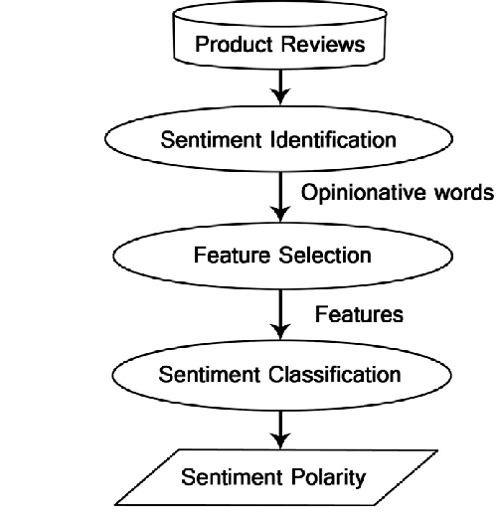
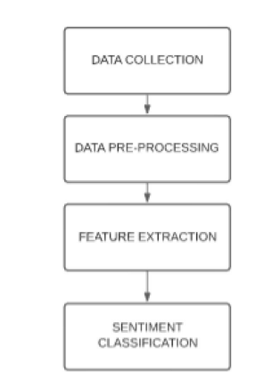
Sentiment Analysis :

Slide 14
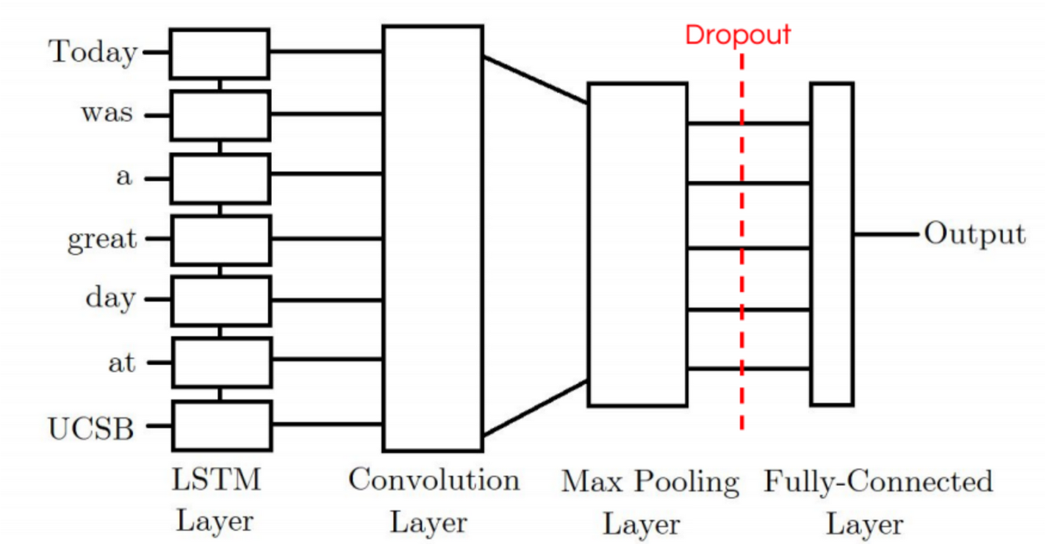
Architecture Diagram
LSTM + CNN model:

Slide 15
UML Diagram
Twitter Comments
17-05-2024

Slide 16
Result
17-05-2024

Slide 17
Result
17-05-2024

Slide 18
Result
17-05-2024

Slide 19
Result
17-05-2024

Slide 20
Result
17-05-2024

Slide 21
THANK YOU !!

